Slide 1
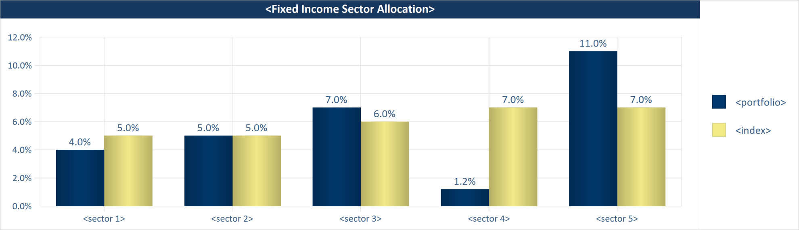
14). Sector Allocation – Comparison with Indices, Fixed Income (Chart)
Description: This object displays the percent invested in each fixed income sector along with sector weightings of up to two indices. If the portfolio has asset classes other than fixed income, the percent invested in each sector is calculated as a percent of the fixed income asset class. **Please note: sector weights for indices must be sent for this object to properly display data.
Notes:
**Chart should conform to new L&F.
**Settings common to charts should be included.
**Chart Title: Income Sector Allocation
**Cash is always shown last.
**<weight type>: Ending Weight as of mm/dd/yyyy
OR Average Weight During mm/dd/yyyy – mm/dd/yyyy
**Weighting type – ONLY show “average weight” if avg. data is present for BOTH portfolio and index.
**Consolidate “Corporate” – only applicable if using FI analytics data, and the data provides the breakdown. Let’s discuss… also, need to consider if indices have the same breakdown or not.
Settings:
**Perf. Setting to select “Show data as of”. **quarter-end is the default.
Setting Name: Weight type
Type: dropdown
Values (for drop downs): end of period; average weight
Default Value: end of period
Help Text: Please note: this setting will provide options only if you send both end of period and average weights to Assette. If you select “average weight”, then select the time period from below.
  Setting Name: Time period
  Type: dropdown
  Values (for drop downs): {list of periods sent by client}
  Default Value: quarter
  Help Text:
**Child setting live only if “average weight” is selected.
Setting Name: Index 1
Type: dropdown
Values (for drop downs): default 1; default 2; {list of FI benchmarks that have sector weights}
Default Value: default 1
Help Text: Selecting one of the “default” values will display benchmarks associated with the account in your portfolio accounting system. “Default 1” will display the first benchmark associated with the account, “default 2” will display the second one and so on. **Please Note: Assette must receive sector weights for indices that are represented by “default”. Further, if selecting more than one index, all selected indices must contain the same sector classification.
…
Setting Name: Index 2 (keep blank; and the same list above. Default = keep blank).
Help Text: If you select to display data for a second index, an additional bar will be added to the chart. The chart area will remain the same, but the bars will become thinner.
Setting Name: Show cash
Type: dropdown
Values (for drop downs): yes; no
Default Value: no
Help Text: If you select “yes”, cash value will be displayed as another sector. If you select to show cash, the cash sector will always be shown as the last sector – the sort order does not apply.
Setting Name: Consolidate “Corporate”
Type: dropdown
Values (for drop downs): yes; no
Default Value: yes
Help Text: If your data provides sub-sector information for Corporate, selecting “yes” will display “Corporate” as one sector. If you select “no”, sub-sectors under corporate (i.e. Industrials, Financials, Utilities, etc.) will be displayed as separate sectors (Corporate will not be shown as a sector).
Setting Name: On legend, show
Type: dropdown
Values (for drop downs): “Portfolio”; “Composite”; friendly name; actual account name
Default Value: “Portfolio”
Help Text: This setting determines if the word “Portfolio”, “Composite”, the friendly name or the actual account name is displayed in the chart legend. If you select “friendly name” and If a friendly name is not setup, the actual account name will be used. The friendly names are setup via the Account Administration tool.
Setting Name: Show composite data
Type: dropdown
Values (for drop downs): yes; no
Default Value: no
Help Text: This setting applies to client accounts (non-composites). When generating reports for an account, if data displayed in this object is available for the account, then the account specific data will be used. Instead, if you want to display composite-level data, then select “yes” here – the data for the composite the account belongs to will be displayed. If you do not send account-level data for this object, then composite-level data will be used automatically. When generating reports for a composite, the actual composite data will be used (as long as the data is sent to Assette) irrespective of the selection. If you select to display composite data, you may select to display the footnote “Portfolio data is based on <composite name> data”. If there is no account data, and composite data is displayed, then the footnote will automatically be displayed. **Please note: Composite data is not available in Assette Easy products, hence this setting is not applicable.
  Setting Name: Display footnote
  Type: dropdown
  Values (for drop downs): yes; no
  Default Value: yes
Setting Name: Use friendly name for sector name
Type: dropdown
Values (for drop downs): yes; no
Default Value: no
Help Text: If “yes” is selected the identifier displayed for each sector will be the “Friendly Name” you have specified for each sector. Use the friendly name to prevent long sector names wrapping into multiple rows or cutting off. The friendly names are setup via the Data Administration utility. If there is no friendly name setup for a particular sector, then the actual sector name will be used.
Setting Name: Sort by
Type: dropdown
Values (for drop downs): default sector order; portfolio sector %, ascending; portfolio sector %, descending
Default Value: default sector order
Help Text:
Number Formatting
**Decimal places on all columns: Default for MVs – zero decimals; Default for % - 2 decimals.
**currency formatting on currency fields

Slide 2
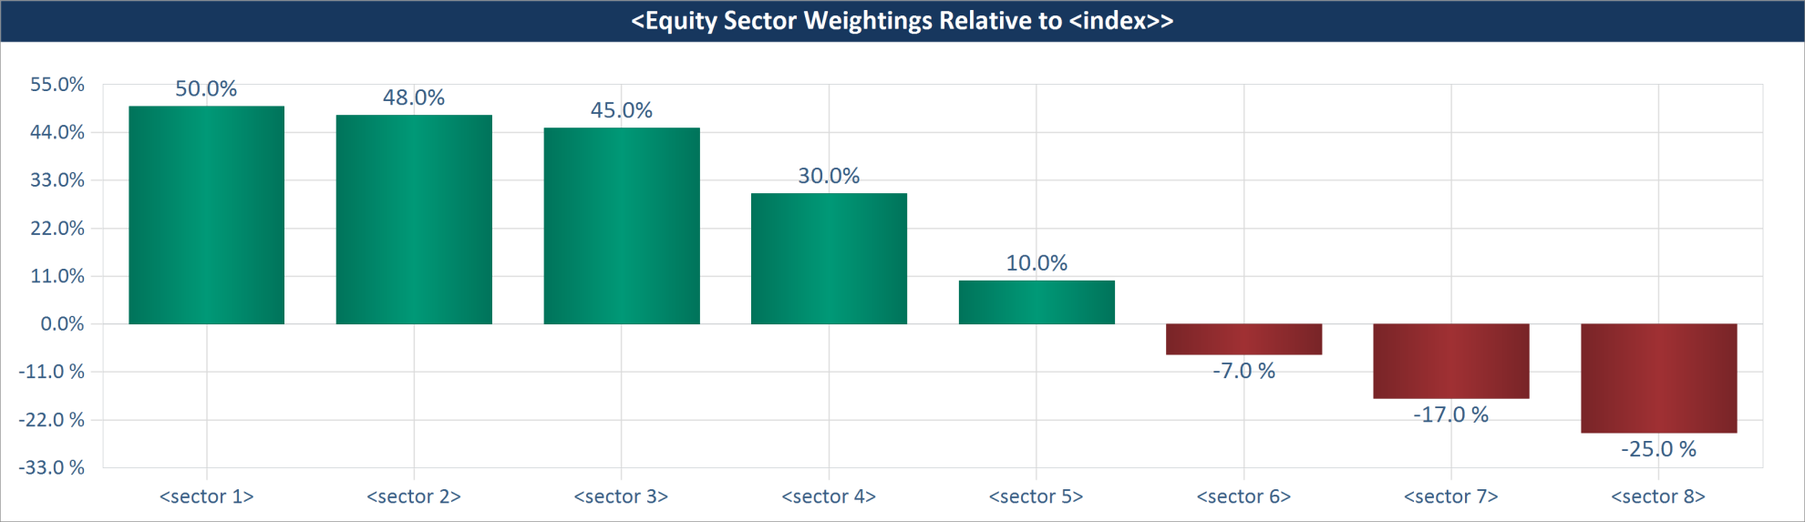
15). Sector Allocation – Relative Sector Weightings, Equity (Chart)
Description: This object displays the percent invested in each equity sector relative to sector weightings of an index. If the portfolio has asset classes other than equity, the percent invested in each sector is calculated as a percent of the equity asset class. **Please note: sector weights for indices must be sent for this object to properly display data.
Settings:
**Perf. Setting to select “Show data as of”. **quarter-end is the default.
Setting Name: Weight type
Type: dropdown
Values (for drop downs): end of period; average weight
Default Value: end of period
Help Text: Please note: this setting will provide options only if you send both end of period and average weights to Assette. If you select “average weight”, then select the time period from below.
  Setting Name: Time period
  Type: dropdown
  Values (for drop downs): {list of periods sent by client}
  Default Value: quarter
  Help Text:
**Child setting live only if “average weight” is selected.
Setting Name: Index
Type: dropdown
Values (for drop downs): default 1; default 2; {list of equity benchmarks that have sector weights}
Default Value: default 1
Help Text: Selecting one of the “default” values will display benchmarks associated with the account in your portfolio accounting system. “Default 1” will display the first benchmark associated with the account, “default 2” will display the second one and so on. **Please Note: Assette must receive sector weights for indices that are represented by “default”. Further, if selecting more than one index, all selected indices must contain the same sector classification.
Setting Name: Show cash
Type: dropdown
Values (for drop downs): yes; no
Default Value: no
Help Text: If you select “yes”, cash value will be displayed as another sector. If you select to show cash, the cash sector will always be shown as the last sector – the sort order does not apply.
Setting Name: Show composite data
Type: dropdown
Values (for drop downs): yes; no
Default Value: no
Help Text: This setting applies to client accounts (non-composites). When generating reports for an account, if data displayed in this object is available for the account, then the account specific data will be used. Instead, if you want to display composite-level data, then select “yes” here – the data for the composite the account belongs to will be displayed. If you do not send account-level data for this object, then composite-level data will be used automatically. When generating reports for a composite, the actual composite data will be used (as long as the data is sent to Assette) irrespective of the selection. If you select to display composite data, you may select to display the footnote “Portfolio data is based on <composite name> data”. If there is no account data, and composite data is displayed, then the footnote will automatically be displayed. **Please note: Composite data is not available in Assette Easy products, hence this setting is not applicable.
  Setting Name: Display footnote
  Type: dropdown
  Values (for drop downs): yes; no
  Default Value: yes
Setting Name: Use friendly name for sector name
Type: dropdown
Values (for drop downs): yes; no
Default Value: no
Help Text: If “yes” is selected the identifier displayed for each sector will be the “Friendly Name” you have specified for each sector. Use the friendly name to prevent long sector names wrapping into multiple rows or cutting off. The friendly names are setup via the Data Administration utility. If there is no friendly name setup for a particular sector, then the actual sector name will be used.
Setting Name: Sort by
Type: dropdown
Values (for drop downs): relative weightings, descending; relative weightings, ascending; default sector order
Default Value: ): relative weightings, descending
Help Text:
Number Formatting
**Decimal places on all columns: Default for MVs – zero decimals; Default for % - 2 decimals.
**currency formatting on currency fields
Notes:
**Chart should conform to new L&F.
**Settings common to charts should be included.
**Chart Title: “Sector Weightings Relative to <index>”
**<weight type>: Ending Weight as of mm/dd/yyyy
OR Average Weight During mm/dd/yyyy – mm/dd/yyyy
**Weighting type – ONLY show “average weight” if avg. data is present for BOTH portfolio and index.

Slide 3
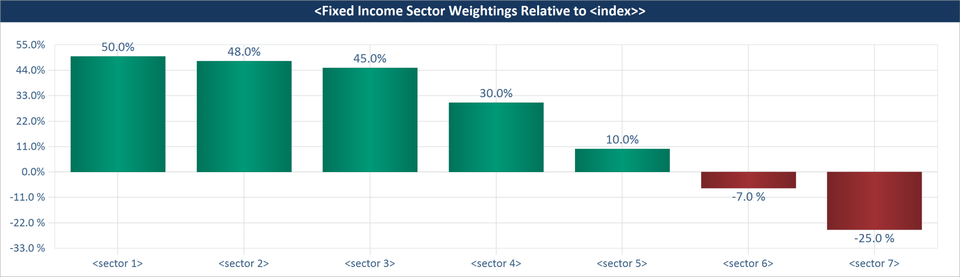
16). Sector Allocation – Relative Sector Weightings, Fixed Income (Chart)
Description: This object displays the percent invested in each fixed income sector relative to sector weightings of an index. If the portfolio has asset classes other than fixed income, the percent invested in each sector is calculated as a percent of the fixed income asset class. **Please note: sector weights for indices must be sent for this object to properly display data.
Settings:
**Perf. Setting to select “Show data as of”. **quarter-end is the default.
Setting Name: Weight type
Type: dropdown
Values (for drop downs): end of period; average weight
Default Value: end of period
Help Text: Please note: this setting will provide options only if you send both end of period and average weights to Assette. If you select “average weight”, then select the time period from below.
  Setting Name: Time period
  Type: dropdown
  Values (for drop downs): {list of periods sent by client}
  Default Value: quarter
  Help Text:
**Child setting live only if “average weight” is selected.
Setting Name: Index
Type: dropdown
Values (for drop downs): default 1; default 2; {list of FI benchmarks that have sector weights}
Default Value: default 1
Help Text: Selecting one of the “default” values will display benchmarks associated with the account in your portfolio accounting system. “Default 1” will display the first benchmark associated with the account, “default 2” will display the second one and so on. **Please Note: Assette must receive sector weights for indices that are represented by “default”. Further, if selecting more than one index, all selected indices must contain the same sector classification.
Setting Name: Show cash
Type: dropdown
Values (for drop downs): yes; no
Default Value: no
Help Text: If you select “yes”, cash value will be displayed as another sector. If you select to show cash, the cash sector will always be shown as the last sector – the sort order does not apply.
Setting Name: Consolidate “Corporate”
Type: dropdown
Values (for drop downs): yes; no
Default Value: yes
Help Text: If your data provides sub-sector information for Corporate, selecting “yes” will display “Corporate” as one sector. If you select “no”, sub-sectors under corporate (i.e. Industrials, Financials, Utilities, etc.) will be displayed as separate sectors (Corporate will not be shown as a sector).
Setting Name: Show composite data
Type: dropdown
Values (for drop downs): yes; no
Default Value: no
Help Text: This setting applies to client accounts (non-composites). When generating reports for an account, if data displayed in this object is available for the account, then the account specific data will be used. Instead, if you want to display composite-level data, then select “yes” here – the data for the composite the account belongs to will be displayed. If you do not send account-level data for this object, then composite-level data will be used automatically. When generating reports for a composite, the actual composite data will be used (as long as the data is sent to Assette) irrespective of the selection. If you select to display composite data, you may select to display the footnote “Portfolio data is based on <composite name> data”. If there is no account data, and composite data is displayed, then the footnote will automatically be displayed. **Please note: Composite data is not available in Assette Easy products, hence this setting is not applicable.
  Setting Name: Display footnote
  Type: dropdown
  Values (for drop downs): yes; no
  Default Value: yes
Setting Name: Use friendly name for sector name
Type: dropdown
Values (for drop downs): yes; no
Default Value: no
Help Text: If “yes” is selected the identifier displayed for each sector will be the “Friendly Name” you have specified for each sector. Use the friendly name to prevent long sector names wrapping into multiple rows or cutting off. The friendly names are setup via the Data Administration utility. If there is no friendly name setup for a particular sector, then the actual sector name will be used.
Setting Name: Sort by
Type: dropdown
Values (for drop downs): relative weightings, descending; relative weightings, ascending; default sector order
Default Value: ): relative weightings, descending
Help Text:
:
Number Formatting
**Decimal places on all columns: Default for MVs – zero decimals; Default for % - 2 decimals.
**currency formatting on currency fields
Notes:
**Chart should conform to new L&F.
**Settings common to charts should be included.
**Chart Title: “Sector Weightings Relative to <index>”
**<weight type>: Ending Weight as of mm/dd/yyyy
OR Average Weight During mm/dd/yyyy – mm/dd/yyyy
**Weighting type – ONLY show “average weight” if avg. data is present for BOTH portfolio and index.
**Consolidate “Corporate” – only applicable if using FI analytics data, and the data provides the breakdown. Let’s discuss… also, need to consider if indices have the same breakdown or not.

Slide 4
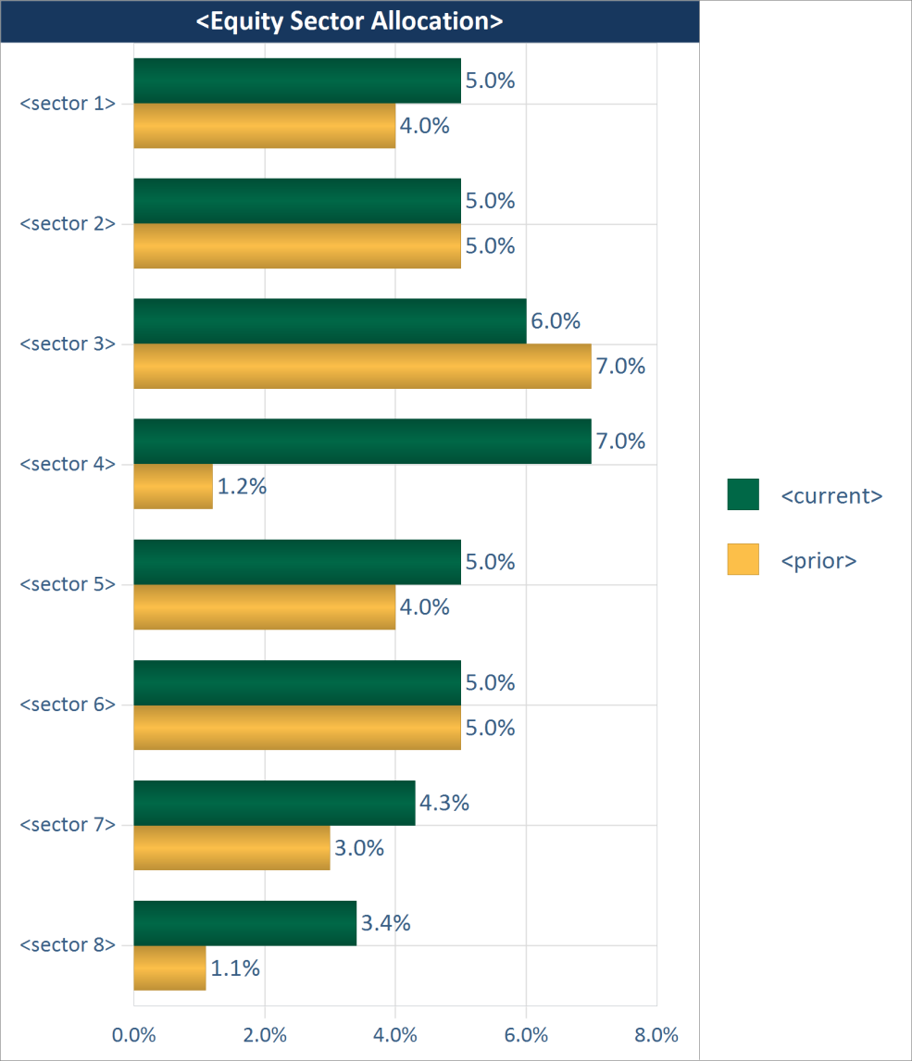
17). Sector Allocation – Comparison with Prior Period, Equity (Chart)
Description: This object displays the current equity sector allocation of the portfolio along with the allocation for a prior period you select. The actual sectors defined in your data will be displayed.
Settings:
Setting Name: Prior period
Type: dropdown
Values (for drop downs): prior month-end; prior quarter-end; prior year-end
Default Value: prior quarter-end
Help Text:
Setting Name: Show cash
Type: dropdown
Values (for drop downs): yes; no
Default Value: no
Help Text: If you select “yes”, cash value will be displayed as another sector. If you select to show cash, the cash sector will always be shown as the last sector – the sort order does not apply.
Setting Name: Show composite data
Type: dropdown
Values (for drop downs): yes; no
Default Value: no
Help Text: This setting applies to client accounts (non-composites). When generating reports for an account, if data displayed in this object is available for the account, then the account specific data will be used. Instead, if you want to display composite-level data, then select “yes” here – the data for the composite the account belongs to will be displayed. If you do not send account-level data for this object, then composite-level data will be used automatically. When generating reports for a composite, the actual composite data will be used (as long as the data is sent to Assette) irrespective of the selection. If you select to display composite data, you may select to display the footnote “Portfolio data is based on <composite name> data”. If there is no account data, and composite data is displayed, then the footnote will automatically be displayed. **Please note: Composite data is not available in Assette Easy products, hence this setting is not applicable.
  Setting Name: Display footnote
  Type: dropdown
  Values (for drop downs): yes; no
  Default Value: yes
Setting Name: Use friendly name for sector name
Type: dropdown
Values (for drop downs): yes; no
Default Value: no
Help Text: If “yes” is selected the identifier displayed for each sector will be the “Friendly Name” you have specified for each sector. Use the friendly name to prevent long sector names wrapping into multiple rows or cutting off. The friendly names are setup via the Data Administration utility. If there is no friendly name setup for a particular sector, then the actual sector name will be used.
Setting Name: Sort by
Type: dropdown
Values (for drop downs): default sector order; portfolio sector %, ascending; portfolio sector %, descending
Default Value: default sector order
Help Text:
Number Formatting
**Decimal places on all columns: Default for MVs – zero decimals; Default for % - 2 decimals.
**currency formatting on currency fields
Notes:
**Cash is always shown last.
2 decimals is the default. Change shell as well.

Slide 5
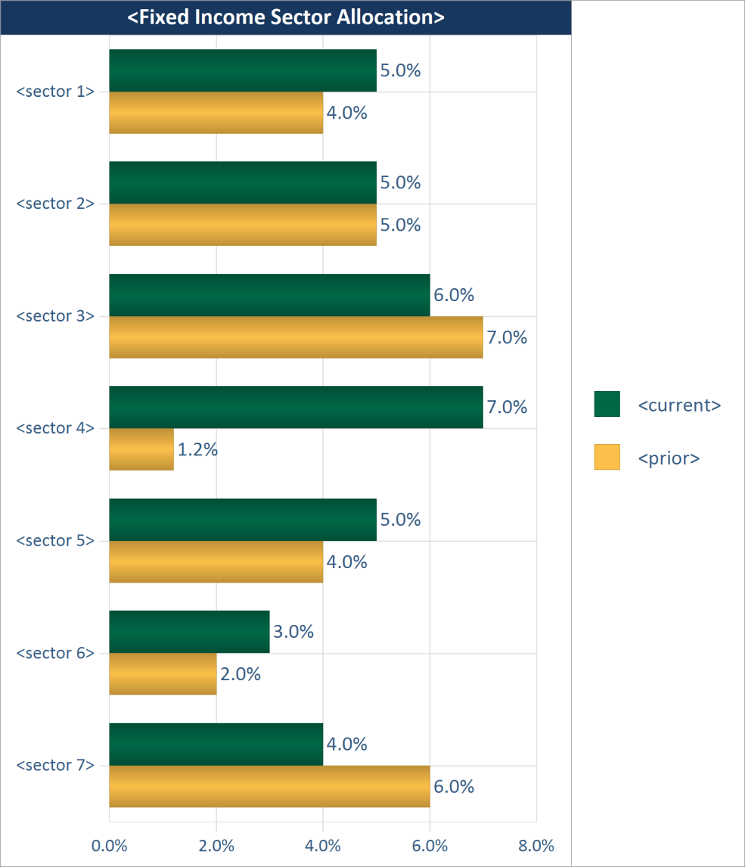
18). Sector Allocation – Comparison with Prior Period, Fixed Income (Chart)
Description: This object displays the current fixed income sector allocation of the portfolio along with the allocation for a prior period you select. The actual sectors defined in your data will be displayed.
Settings:
Setting Name: Prior period
Type: dropdown
Values (for drop downs): prior month-end; prior quarter-end; prior year-end
Default Value: prior quarter-end
Help Text:
Setting Name: Show cash
Type: dropdown
Values (for drop downs): yes; no
Default Value: no
Help Text: If you select “yes”, cash value will be displayed as another sector. If you select to show cash, the cash sector will always be shown as the last sector – the sort order does not apply.
Setting Name: Consolidate “Corporate”
Type: dropdown
Values (for drop downs): yes; no
Default Value: yes
Help Text: If your data provides sub-sector information for Corporate, selecting “yes” will display “Corporate” as one sector. If you select “no”, sub-sectors under corporate (i.e. Industrials, Financials, Utilities, etc.) will be displayed as separate sectors (Corporate will not be shown as a sector).
Setting Name: Show composite data
Type: dropdown
Values (for drop downs): yes; no
Default Value: no
Help Text: This setting applies to client accounts (non-composites). When generating reports for an account, if data displayed in this object is available for the account, then the account specific data will be used. Instead, if you want to display composite-level data, then select “yes” here – the data for the composite the account belongs to will be displayed. If you do not send account-level data for this object, then composite-level data will be used automatically. When generating reports for a composite, the actual composite data will be used (as long as the data is sent to Assette) irrespective of the selection. If you select to display composite data, you may select to display the footnote “Portfolio data is based on <composite name> data”. If there is no account data, and composite data is displayed, then the footnote will automatically be displayed. **Please note: Composite data is not available in Assette Easy products, hence this setting is not applicable.
  Setting Name: Display footnote
  Type: dropdown
  Values (for drop downs): yes; no
  Default Value: yes
Setting Name: Use friendly name for sector name
Type: dropdown
Values (for drop downs): yes; no
Default Value: no
Help Text: If “yes” is selected the identifier displayed for each sector will be the “Friendly Name” you have specified for each sector. Use the friendly name to prevent long sector names wrapping into multiple rows or cutting off. The friendly names are setup via the Data Administration utility. If there is no friendly name setup for a particular sector, then the actual sector name will be used.
Setting Name: Sort by
Type: dropdown
Values (for drop downs): default sector order; portfolio sector %, ascending; portfolio sector %, descending
Default Value: default sector order
Help Text:
Number Formatting
**Decimal places on all columns: Default for MVs – zero decimals; Default for % - 2 decimals.
**currency formatting on currency fields
2 decimals is the default. Change shell as well.
Notes:
****Cash is always shown last.
**Consolidate “Corporate” – only applicable if using FI analytics data, and the data provides the breakdown. Let’s discuss… also, need to consider if indices have the same breakdown or not.

Slide 6
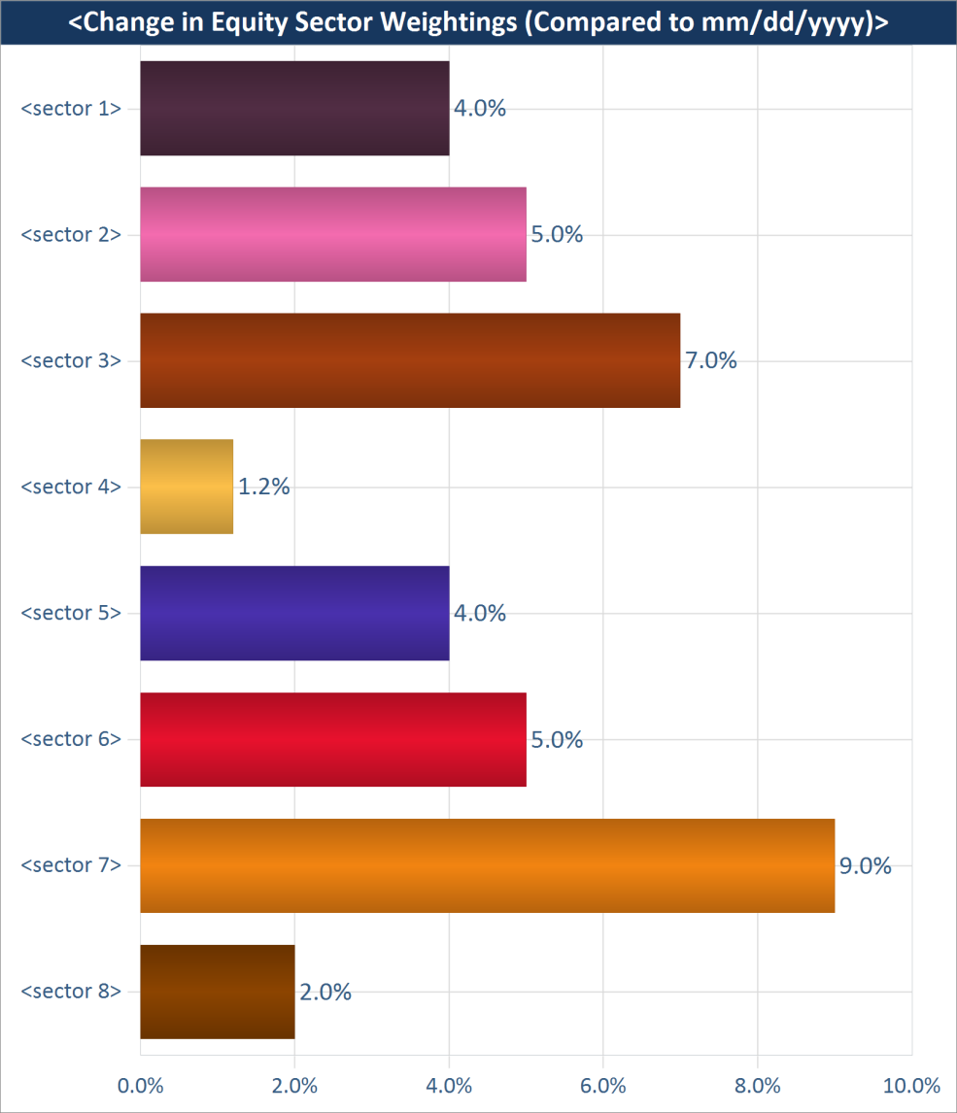
19). Sector Allocation – Change in Weightings Compared to Prior Period, Equity (Chart)
Description: This object displays the current equity sector allocation of the portfolio along with the allocation for a prior period you select. The actual sectors defined in your data will be displayed.
Settings:
Setting Name: Prior period
Type: dropdown
Values (for drop downs): prior month-end; prior quarter-end; prior year-end
Default Value: prior quarter-end
Help Text:
Setting Name: Show cash
Type: dropdown
Values (for drop downs): yes; no
Default Value: no
Help Text: If you select “yes”, cash value will be displayed as another sector. If you select to show cash, the cash sector will always be shown as the last sector – the sort order does not apply.
Setting Name: Sort by
Type: dropdown
Values (for drop downs): default sector order; portfolio sector %, ascending; portfolio sector %, descending
Default Value: default sector order
Help Text:
Setting Name: Show composite data
Type: dropdown
Values (for drop downs): yes; no
Default Value: no
Help Text: This setting applies to client accounts (non-composites). When generating reports for an account, if data displayed in this object is available for the account, then the account specific data will be used. Instead, if you want to display composite-level data, then select “yes” here – the data for the composite the account belongs to will be displayed. If you do not send account-level data for this object, then composite-level data will be used automatically. When generating reports for a composite, the actual composite data will be used (as long as the data is sent to Assette) irrespective of the selection. If you select to display composite data, you may select to display the footnote “Portfolio data is based on <composite name> data”. If there is no account data, and composite data is displayed, then the footnote will automatically be displayed. **Please note: Composite data is not available in Assette Easy products, hence this setting is not applicable.
  Setting Name: Display footnote
  Type: dropdown
  Values (for drop downs): yes; no
  Default Value: yes
Setting Name: Use friendly name for sector name
Type: dropdown
Values (for drop downs): yes; no
Default Value: no
Help Text: If “yes” is selected the identifier displayed for each sector will be the “Friendly Name” you have specified for each sector. Use the friendly name to prevent long sector names wrapping into multiple rows or cutting off. The friendly names are setup via the Data Administration utility. If there is no friendly name setup for a particular sector, then the actual sector name will be used.
Number Formatting
**Decimal places on all columns: Default for MVs – zero decimals; Default for % - 2 decimals.
**currency formatting on currency fields
2 decimals is the default. Change shell as well.
Notes:
**No Legend
**Cash is always shown last.
Sorting should be top to bottom in legend

Slide 7
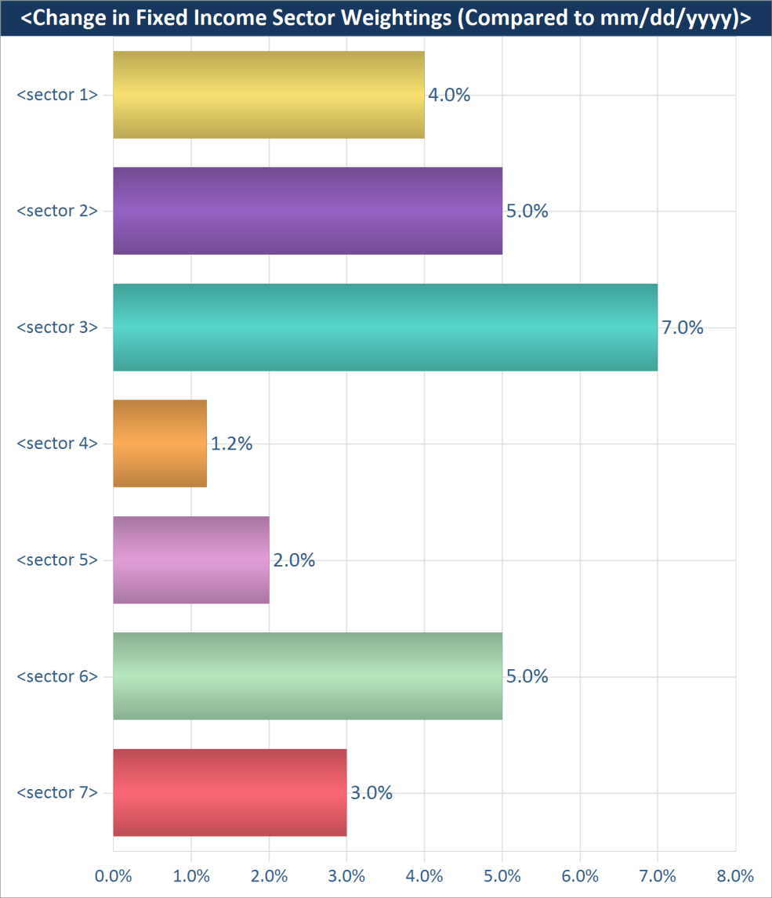
20). Sector Allocation – Change in Weightings Compared to Prior Period, Fixed Income (Chart)
Description: This object displays the current fixed income sector allocation of the portfolio along with the allocation for a prior period you select. The actual sectors defined in your data will be displayed.
Settings:
Setting Name: Prior period
Type: dropdown
Values (for drop downs): prior month-end; prior quarter-end; prior year-end
Default Value: prior quarter-end
Help Text:
Setting Name: Show cash
Type: dropdown
Values (for drop downs): yes; no
Default Value: no
Help Text: If you select “yes”, cash value will be displayed as another sector. If you select to show cash, the cash sector will always be shown as the last sector – the sort order does not apply.
Setting Name: Consolidate “Corporate”
Type: dropdown
Values (for drop downs): yes; no
Default Value: yes
Help Text: If your data provides sub-sector information for Corporate, selecting “yes” will display “Corporate” as one sector. If you select “no”, sub-sectors under corporate (i.e. Industrials, Financials, Utilities, etc.) will be displayed as separate sectors (Corporate will not be shown as a sector).
Setting Name: Show composite data
Type: dropdown
Values (for drop downs): yes; no
Default Value: no
Help Text: This setting applies to client accounts (non-composites). When generating reports for an account, if data displayed in this object is available for the account, then the account specific data will be used. Instead, if you want to display composite-level data, then select “yes” here – the data for the composite the account belongs to will be displayed. If you do not send account-level data for this object, then composite-level data will be used automatically. When generating reports for a composite, the actual composite data will be used (as long as the data is sent to Assette) irrespective of the selection. If you select to display composite data, you may select to display the footnote “Portfolio data is based on <composite name> data”. If there is no account data, and composite data is displayed, then the footnote will automatically be displayed. **Please note: Composite data is not available in Assette Easy products, hence this setting is not applicable.
  Setting Name: Display footnote
  Type: dropdown
  Values (for drop downs): yes; no
  Default Value: yes
Setting Name: Use friendly name for sector name
Type: dropdown
Values (for drop downs): yes; no
Default Value: no
Help Text: If “yes” is selected the identifier displayed for each sector will be the “Friendly Name” you have specified for each sector. Use the friendly name to prevent long sector names wrapping into multiple rows or cutting off. The friendly names are setup via the Data Administration utility. If there is no friendly name setup for a particular sector, then the actual sector name will be used.
Setting Name: Sort by
Type: dropdown
Values (for drop downs): default sector order; portfolio sector %, ascending; portfolio sector %, descending
Default Value: default sector order
Help Text:
Number Formatting
**Decimal places on all columns: Default for MVs – zero decimals; Default for % - 2 decimals.
**currency formatting on currency fields
Notes:
**No Legend
**Cash is always shown last.
Sorting should be top to bottom in legend
**Consolidate “Corporate” – only applicable if using FI analytics data, and the data provides the breakdown. Let’s discuss… also, need to consider if indices have the same breakdown or not.
2 decimals is the default. Change shell as well.

Slide 8
MA
1). Holdings – Portfolio Holdings Detail (Table)
Description: This object shows all portfolio holdings categorized by asset class, and then optionally by a subcategory (sector, industry or security type) within each asset class. The subcategory for each asset class is specified during system setup.
<Portfolio Holdings>
Security |  | <colm. 1> | Quantity | Unit Cost ($) | Total Cost ($) | Price ($) | Value ($) | Percent of Portfolio | Unrealized Gain/Loss ($) | Yield
 | <asset class>
<subcategory>
<security> |  | <selection> | <nn,nnn> | <nnn.nn> | <nnn,nnn.nn> | 100,000.00 | <nn,nnn,nnn.nn> | <n.nn%> | <nn,nnn,nnn.nn> | <n.nn%>
Subtotal |  |  |  |  | <nnn,nnn.nn> |  | <n,nnn,nnn.nn> | <n.nn%> | <n,nnn,nnn.nn> | <n.nn%>
<subcategory>
<security> |  | <selection> | <nn,nnn> | <nnn.nn> | <nnn,nnn.nn> | <nnn.nn> | <nn,nnn,nnn.nn> | <n.nn%> | <nn,nnn,nnn.nn>
Subtotal |  |  |  |  | <nnn,nnn.nn> |  | <n,nnn,nnn.nn> | <n.nn%> | <n,nnn,nnn.nn> | <n.nn%>
TOTAL |  |  |  |  | <nnn,nnn.nn> |  | <n,nnn,nnn.nn> | <n.nn%> | <n,nnn,nnn.nn> | <n.nn%>
 | <asset class>
<subcategory>
<security> |  | <selection> | <nn,nnn> | <nnn.nn> | <nnn,nnn.nn> | <nnn.nn> | <nn,nnn,nnn.nn> | <n.nn%> | <nn,nnn,nnn.nn> | <n.nn%>
Subtotal |  |  |  |  | <nnn,nnn.nn> |  | <n,nnn,nnn.nn> | <n.nn%> | <n,nnn,nnn.nn> | <n.nn%>
<subcategory>
<security> |  | <selection> | <nn,nnn> | <nnn.nn> | <nnn,nnn.nn> | <nnn.nn> | <nn,nnn,nnn.nn> | <n.nn%> | <nn,nnn,nnn.nn> | <n.nn%>
Subtotal |  |  |  |  | <nnn,nnn.nn> |  | <n,nnn,nnn.nn> | <n.nn%> | <n,nnn,nnn.nn> | <n.nn%>
TOTAL |  |  |  |  | <nnn,nnn.nn> |  | <n,nnn,nnn.nn> | <n.nn%> | <n,nnn,nnn.nn> | <n.nn%>
GRAND TOTAL |  |  |  |  | <nnn,nnn.nn> |  | <n,nnn,nnn.nn> | <n.nn%> | <n,nnn,nnn.nn> | <n.nn%>
Accrued Income |  |  |  |  |  |  | <n,nnn,nnn.nn>
GRAND TOTAL WITH ACCRUED INCOME |  |  |  |  |  |  | <n,nnn,nnn.nn>

Slide 9
MA
2). Holdings – Portfolio Holdings Detail with Annual Income (Table)
Description: This object shows all portfolio holdings categorized by asset class, and then optionally by a subcategory (sector, industry or security type) within each asset class. The subcategory for each asset class is specified during system setup.
<Portfolio Holdings>
Security |  | <colm. 1> | Quantity | Unit Cost ($) | Total Cost ($) | Price ($) | Value ($) | Percent of Portfolio | Annual Income ($) | Yield
 | <asset class>
<subcategory>
<security> |  | <selection> | <nn,nnn> | <nnn.nn> | <nnn,nnn.nn> | 100,000.00 | <nn,nnn,nnn.nn> | <n.nn%> | <nn,nnn.nn> | <n.nn%>
Subtotal |  |  |  |  | <nnn,nnn.nn> |  | <n,nnn,nnn.nn> | <n.nn%> | <nn,nnn.nn> | <n.nn%>
<subcategory>
<security> |  | <selection> | <nn,nnn> | <nnn.nn> | <nnn,nnn.nn> | <nnn.nn> | <nn,nnn,nnn.nn> | <n.nn%> | <nn,nnn.nn>
Subtotal |  |  |  |  | <nnn,nnn.nn> |  | <n,nnn,nnn.nn> | <n.nn%> | <nn,nnn.nn> | <n.nn%>
TOTAL |  |  |  |  | <nnn,nnn.nn> |  | <n,nnn,nnn.nn> | <n.nn%> | <nn,nnn.nn> | <n.nn%>
 | <asset class>
<subcategory>
<security> |  | <selection> | <nn,nnn> | <nnn.nn> | <nnn,nnn.nn> | <nnn.nn> | <nn,nnn,nnn.nn> | <n.nn%> | <nn,nnn.nn> | <n.nn%>
Subtotal |  |  |  |  | <nnn,nnn.nn> |  | <n,nnn,nnn.nn> | <n.nn%> | <nn,nnn.nn> | <n.nn%>
<subcategory>
<security> |  | <selection> | <nn,nnn> | <nnn.nn> | <nnn,nnn.nn> | <nnn.nn> | <nn,nnn,nnn.nn> | <n.nn%> | <nn,nnn.nn> | <n.nn%>
Subtotal |  |  |  |  | <nnn,nnn.nn> |  | <n,nnn,nnn.nn> | <n.nn%> | <nn,nnn.nn> | <n.nn%>
TOTAL |  |  |  |  | <nnn,nnn.nn> |  | <n,nnn,nnn.nn> | <n.nn%> | <nn,nnn.nn> | <n.nn%>
GRAND TOTAL |  |  |  |  | <nnn,nnn.nn> |  | <n,nnn,nnn.nn> | <n.nn%> | <nn,nnn.nn> | <n.nn%>
Accrued Income |  |  |  |  |  |  | <n,nnn,nnn.nn>
GRAND TOTAL WITH ACCRUED INCOME |  |  |  |  |  |  | <n,nnn,nnn.nn>

Slide 10
MA
3). Holdings – Portfolio Holdings Summary (Table)
Description: This object shows all portfolio holdings categorized by asset class, and then optionally by a subcategory (sector, industry or security type) within each asset class. The subcategory for each asset class is specified during system setup.
<Portfolio Holdings>
Security |  | Symbol | Quantity | Price ($) | Value ($) | Percent of Portfolio
 | <asset class>
<subcategory>
<security> |  | <symbol> | <nn,nnn> | <nnn.nn> | <nn,nnn,nnn.nn> | <nn.nn%>
Subtotal |  |  |  |  | <n,nnn,nnn.nn> | <nn.nn%>
<subcategory>
<security> |  | <symbol> | <nn,nnn> | <nnn.nn> | <nn,nnn,nnn.nn> | <nn.nn%>
Subtotal |  |  |  |  | <n,nnn,nnn.nn> | <nn.nn%>
TOTAL |  |  |  |  | <n,nnn,nnn.nn> | <nn.nn%>
 | <asset class>
<subcategory>
<security> |  | <symbol> | <nn,nnn> | <nnn.nn> | <nn,nnn,nnn.nn> | <nn.nn%>
Subtotal |  |  |  |  | <n,nnn,nnn.nn> | <nn.nn%>
<subcategory>
<security> |  | <symbol> | <nn,nnn> | <nnn.nn> | <nn,nnn,nnn.nn> | <nn.nn%>
Subtotal |  |  |  |  | <n,nnn,nnn.nn> | <nn.nn%>
TOTAL |  |  |  |  | <n,nnn,nnn.nn> | <nn.nn%>
GRAND TOTAL |  |  |  |  | <n,nnn,nnn.nn> | <nn.nn%>
Accrued Income |  |  |  |  | <n,nnn,nnn.nn>
GRAND TOTAL WITH ACCRUED INCOME |  |  |  |  | <n,nnn,nnn.nn>

Slide 11
MA
4). Holdings – [Group] Portfolio Holdings Summary (Table)
Description: This object shows holdings in a relationship by sub-account and a category (asset class, sector, industry or security type ) within each sub-account.
<Portfolio Holdings>
Security |  | Symbol | Quantity | Price ($) | Value ($) | Percent of Portfolio
 | <account name> (<a/c number>)
 | <category>
<security> |  | <symbol> | <nn,nnn> | <nnn.nn> | <nn,nnn,nnn.nn> | <nn.nn%>
Subtotal |  |  |  |  | <n,nnn,nnn.nn> | <nn.nn%>
 | <category>
<security> |  | <symbol> | <nn,nnn> | <nnn.nn> | <nn,nnn,nnn.nn> | <nn.nn%>
Subtotal |  |  |  |  | <n,nnn,nnn.nn> | <nn.nn%>
Total |  |  |  |  | <n,nnn,nnn.nn> | <nn.nn%>
Accrued Income |  |  |  |  | <n,nnn,nnn.nn>
Total with Accrued Income |  |  |  |  | <n,nnn,nnn.nn>
 | <account name> (<a/c number>)
 | <category>
<security> |  | <symbol> | <nn,nnn> | <nnn.nn> | <nn,nnn,nnn.nn> | <nn.nn%>
Subtotal |  |  |  |  | <n,nnn,nnn.nn> | <nn.nn%>
 | <category>
<security> |  | <symbol> | <nn,nnn> | <nnn.nn> | <nn,nnn,nnn.nn> | <nn.nn%>
Subtotal |  |  |  |  | <n,nnn,nnn.nn> | <nn.nn%>
Total |  |  |  |  | <n,nnn,nnn.nn> | <nn.nn%>
Accrued Income |  |  |  |  | <n,nnn,nnn.nn>
Total with Accrued Income |  |  |  |  | <n,nnn,nnn.nn>
GRAND TOTAL |  |  |  |  | <n,nnn,nnn.nn>

Slide 12
MA
5). Holdings – Top/Bottom Holdings (Table)
Description: This object displays top/bottom securities of the entire portfolio. You can specify the top/bottom number to display.
Settings:
Setting Name: Show
Type: dropdown
Values (for drop downs): top holdings; bottom holdings
Default Value: top holdings
Help Text:
Setting Name: Number to show
Type: numeric entry box
Values (for drop downs): n/a
Default Value: 10
Help Text:
Setting Name: Sort by
Type: dropdown
Values (for drop downs): % of portfolio, ascending; % of portfolio, descending
Default Value % of portfolio, descending
Help Text:
Number Formatting
**Decimal places on all columns: Default for MVs – zero decimals; Default for % - 2 decimals.
**currency formatting on currency fields
<<type> <n> Holdings>
Security | Value | Percent of Portfolio
<security> | <$nn,nnn,nnn> | <nn.nn%>
<security> | <$nn,nnn,nnn> | <nn.nn%>
<security> | <$nn,nnn,nnn> | <nn.nn%>
<security> | <$nn,nnn,nnn> | <nn.nn%>
<security> | <$nn,nnn,nnn> | <nn.nn%>
TOTAL | <$nn,nnn,nnn> | <nn.nn%>
Notes:
**If there is a tie, consider the purchase date, and pick the OLDEST for both top and bottom.
**Calculate out to max. decimal places to minimize ties.

Slide 13
6). Holdings – Holdings with Descriptions/Rationale (Table)
Description: This object displays top/bottom securities of the entire portfolio, along with a description/rationale of/for each security. You can specify the top/bottom number to display. **Please note: Description/rationale data needs to be provided to Assette in order to display the rationale. If a particular security doesn’t have a description/rationale, then the description for that security will contain a dash.
<Portfolio Holdings with Descriptions>
Security | Value | Percent of Portfolio | Description
<security> | <$nn,nnn,nnn> | <nn.nn%> | <description>
<security> | <$nn,nnn,nnn> | <nn.nn%> | <description>
<security> | <$nn,nnn,nnn> | <nn.nn%> | <description>
<security> | <$nn,nnn,nnn> | <nn.nn%> | <description>
<security> | <$nn,nnn,nnn> | <nn.nn%> | <description>
<security> | <$nn,nnn,nnn> | <nn.nn%> | <description>
<security> | <$nn,nnn,nnn> | <nn.nn%> | <description>
TOTAL | <$nn,nnn,nnn> | <nn.nn%>
Notes:
**If there is a tie, consider the purchase date, and pick the OLDEST for both top and bottom.
**Calculate out to max. decimal places to minimize ties.
**If there is no description/rationale updated for the As of Date, then display below error (this is different to only a few securities missing rationale, in which case we display a dash in the row):
Object Name: {object name as above}
The descriptions/rationale for {mm/dd/yyyy} has not been updated. Please contact the person responsible for updating data, and request the descriptions/rationale data to be uploaded to Assette. After that, re-generate the report.”
Settings:
Setting Name: Show
Type: dropdown
Values (for drop downs): top holdings; bottom holdings; all holdings
Default Value: top holdings
Help Text:
  Setting Name: Number to show
  Type: numeric entry box
  Values (for drop downs): n/a
  Default Value: 10
  Help Text:
**Child setting applicable only if top/bottom is selected – not for ALL.
Setting Name: Sort by
Type: dropdown
Values (for drop downs): % of portfolio, ascending; % of portfolio, descending
Default Value % of portfolio, descending
Help Text:
Number Formatting
**Decimal places on all columns: Default for MVs – zero decimals; Default for % - 2 decimals.
**currency formatting on currency fields

Slide 14
MA
7). Holdings – Asset Class and Subcategory Summary (Table)
Description: This object shows the holdings of the portfolio rolled up by asset class and subcategory (sector, industry or security type) within each asset class. The subcategory for each asset class is specified during system setup.
<Portfolio Holdings Summary>
Asset Class |  | Total Cost | Value | Percent of Portfolio | Unrealized Gain/Loss
 | <asset class>
<subcategory> |  | <$nn,nnn,nnn> | <$nn,nnn,nnn> | <nn.nn%> | <$nn,nnn,nnn>
<subcategory> |  | <$nn,nnn,nnn> | <$nn,nnn,nnn> | <nn.nn%> | <$nn,nnn,nnn>
Subtotal |  | <$nn,nnn,nnn> | <$nn,nnn,nnn> | <nn.nn%> | <$nn,nnn,nnn>
 | <asset class>
<subcategory> |  | <$nn,nnn,nnn> | <$nn,nnn,nnn> | <nn.nn%> | <$nn,nnn,nnn>
<subcategory> |  | <$nn,nnn,nnn> | <$nn,nnn,nnn> | <nn.nn%> | <$nn,nnn,nnn>
Subtotal |  | <$nn,nnn,nnn> | <$nn,nnn,nnn> | <nn.nn%> | <$nn,nnn,nnn>
TOTAL |  | <$nn,nnn,nnn> | <$nn,nnn,nnn> | <nn.nn%> | <$nn,nnn,nnn>
Accrued Income |  |  | <$nn,nnn,nnn>
TOTAL WITH ACCRUED INCOME |  |  | <$nn,nnn,nnn>
Settings:
Setting Name: Unsupervised assets
Type: dropdown
Values (for drop downs): show separately; show together; do not show
Default Value: show separately
Help Text: If “show separately” is selected, unsupervised securities will be displayed in a separate section with the title “Unsupervised Assets”. There will be a total row for the section. If “show together” is selected, then unsupervised securities will be displayed under relevant asset classes and subcategories along with other securities. **Please note: If the account does not have securities that are classified as “unsupervised”, this setting has no effect.
Setting Name: Sort by
Type: dropdown
Values (for drop downs): default asset class and subcategory order; asset class & subcategory value, descending;
asset class & subcategory value, ascending;
Default Value: default asset class and subcategory order
Help Text:
Setting Name: Subcategory
Value: “Click here for help”
Help Text: The subcategory to display within each asset class has been set during system implementation time. If there is an asset class with no subcategory, then the subcategories are omitted (only individual securities are displayed). If you want to change the subcategory associated with an asset class, please contact your systems administrator or Assette Client Service at ClientService@assette.com.
Number Formatting
**Decimal places on all columns: Default for MVs – zero decimals; Default for % - 2 decimals.
**currency formatting on currency fields
** Paginating object
**Need to support orphan control

Slide 15
8). Holdings – Holdings with Security Descriptions for One Asset Class (Table)
Description: This object shows the holdings of the portfolio by sector for a selected asset class, along with a description of each security. **Please note: Description data needs to be provided to Assette for the Description column to show data. If a particular security doesn’t have a description, then the description for that security will contain a dash. Further, securities must be coded by industry for the Industry column to display data.
<<asset class> Holdings>
Sector and Security |  | Symbol | Description | Industry
 | <sector>
<security> |  | <symbol> | <description> | <industry>
<security> |  | <symbol> | <description> | <industry>
 | <sector>
<security> |  | <symbol> | <description> | <industry>
<security> |  | <symbol> | <description> | <industry>
Settings:
Setting Name: Asset class
Type: dropdown
Values (for drop downs): {list of asset classes}
Default Value: {keep blank}
Setting Name: Show “Symbol”
Type: dropdown
Values (for drop downs): yes; no
Default Value: yes
Help Text:
Setting Name: Show industry
Type: dropdown
Values (for drop downs): yes; no
Default Value: yes
Help Text: Selecting “no” will remove the column from the generated object.
Setting Name: Sort by
Type: dropdown
Values (for drop downs): default sector order; sector weights, descending;
Default Value: default sector order
Help Text:
Setting Name: Secondary sort by
Type: dropdown
Values (for drop downs): security name, ascending; security weight, descending
Default Value: security weight, descending
Help Text:
Number Formatting
**Decimal places on all columns: Default for MVs – zero decimals; Default for % - 2 decimals.
**currency formatting on currency fields
Notes:
**Sector colors will be based on the selected asset class.
** Paginating object
**Need to support orphan control
**If there is no descriptions updated for the As of Date, then display below error (this is different to only a few securities missing rationale, in which case we display a dash in the row):
Object Name: {name as above}
The descriptions for {mm/dd/yyyy} has not been updated. Please contact the person responsible for updating data, and request the descriptions data to be uploaded to Assette. After that, re-generate the report.”

Slide 16
MA
9). Holdings – Holdings for One Asset Class (Table)
Description: This object shows holdings for one asset class separated by subcategory (sector, industry or security type). The subcategory for each asset class is specified during system setup. Displaying the subcategory is optional.
<<asset class> Holdings>
Sector and Security |  | Symbol | Quantity | Price ($) | Value ($) | Percent of Portfolio
 | <subcategory>
<security> |  | <symbol> | <nn,nnn> | <nnn.nn> | <nn,nnn,nnn.nn> | <nn.nn%>
<security> |  | <symbol> | <nn,nnn> | <nnn.nn> | <nn,nnn,nnn.nn> | <nn.nn%>
Subtotal |  |  |  |  | <n,nnn,nnn.nn> | <nn.nn%>
 | <subcategory>
<security> |  | <symbol> | <nn,nnn> | <nnn.nn> | <nn,nnn,nnn.nn> | <nn.nn%>
<security> |  | <symbol> | <nn,nnn> | <nnn.nn> | <nn,nnn,nnn.nn> | <nn.nn%>
Subtotal |  |  |  |  | <n,nnn,nnn.nn> | <nn.nn%>
TOTAL |  |  |  |  | <n,nnn,nnn.nn> | <nn.nn%>
Accrued Income |  |  |  |  | <n,nnn,nnn.nn>
TOTAL WITH ACCRUED INCOME |  |  |  |  | <n,nnn,nnn.nn>
Notes:
**Sector colors will be based on the selected asset class.
** Paginating object
**Need to support orphan control
Settings:
Setting Name: Asset class
Type: dropdown
Values (for drop downs): {list of asset classes}
Default Value: {keep blank}
Setting Name: Show “Symbol”
Type: dropdown
Values (for drop downs): yes; no
Default Value: yes
Help Text:
Setting Name: Sort by
Type: dropdown
Values (for drop downs): default subcategory order; subcategory weights, descending;
Default Value: default subcategory order
Help Text:
Setting Name: Secondary sort by
Type: dropdown
Values (for drop downs): security name, ascending; security weight, descending
Default Value: security weight, descending
Help Text:
Setting Name: Show subcategory
Type: dropdown
Value: yes; no
Default Value: yes
Help Text: Select “yes” to display subcategories within each class or “no” to omit subcategories and only display securities in each asset class. The subcategory to display within each asset class has been set during system implementation time. If there is an asset class with no subcategory specified, then the subcategories are omitted (only individual securities are displayed) even if you select “yes”. If you want to change the subcategory associated with an asset class, please contact your systems administrator or Assette Client Service at ClientService@assette.com.
Number Formatting
**Decimal places on all columns: Default for MVs – zero decimals; Default for % - 2 decimals.
**currency formatting on currency fields

Slide 17
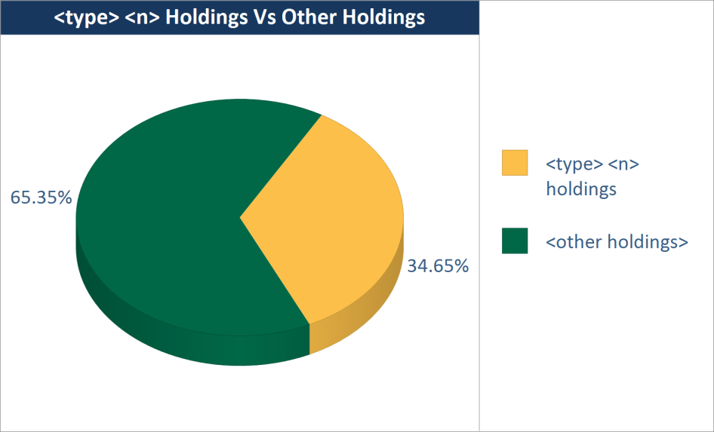
MA
10). Holdings – Top/Bottom Holdings Vs Other Holdings (Chart)
Description: This object displays top/bottom holdings of the portfolio Vs other holdings. You can specify the top/bottom number to display.
Settings:
Setting Name: Show
Type: dropdown
Values (for drop downs): top holdings; bottom holdings
Default Value: top holdings
Help Text:
Setting Name: Number to show
Type: numeric entry box
Values (for drop downs): n/a
Default Value: 10
Help Text:
Common Chart Setting Default: Show figures next to each slice.
Notes:
**Chart should conform to the regular L&F. Will provide colors for two slices.
**Chart should be ¼ page.
**If there is a tie, consider the purchase date, and pick the OLDEST for both top and bottom.
**Calculate out to max. decimal places to minimize ties.

Slide 18
MA
1). Gains/Losses – Realized Gain/Loss Summary (Table)
Description: This object displays a summary of realized gains/losses categorized by short term and long term.
Settings:
Setting Name: Time period
Type: dropdown
Values (for drop downs): <List of 6 periods in Performance and Prtf. Activity Excel file>; custom
Default Value: quarter to date
Help Text:
Need child setting with calendar control if “custom” is selected.
Setting Name: Sort by
Type: dropdown
Values (for drop downs): % of portfolio, ascending; % of portfolio, descending
Default Value % of portfolio, descending
Help Text:
Number Formatting
**Decimal places on all columns: Default for MVs – zero decimals; Default for % - 2 decimals.
**currency formatting on currency fields
<Realized Gain/Loss Summary>
(mm/dd/yyyy – mm/dd/yyyy)
Type | Amount
Short Term | <$nnn,nnn.nn>
Long Term | <$nnn,nnn.nn>
TOTAL | <$nnn,nnn.nn>
Notes:
**Need to have the actual begin and end dates. Begin date is NOT the end date of the previous period. i.e – 07/01/2011 – 09/30/2011 and NOT 06/30/2011 – 09/30/2011.

Slide 19
MA - CHG
2). Gains/Losses – Realized Gain/Loss Detail (Table)
Description: This object shows the realized gains/losses at the security level for a period you select.
<Realized Gain/Loss Detail (mm/dd/yyyy – mm/dd/yyyy)>
Security | Quantity | Purchase Date | Sale Date | Total Cost ($) | Total Proceeds ($) | Short Term Gain/Loss ($) | Long Term Gain/Loss ($)
<security> | <nn,nnn> | mm/dd/yyyy | mm/dd/yyyy | <n,nnn,nnn.nn> | <n,nnn,nnn.nn> | <n,nnn,nnn.nn> | <n,nnn,nnn.nn>
<security> | <nn,nnn> | mm/dd/yyyy | mm/dd/yyyy | <n,nnn,nnn.nn> | <n,nnn,nnn.nn> | <n,nnn,nnn.nn> | <n,nnn,nnn.nn>
<security> | <nn,nnn> | mm/dd/yyyy | mm/dd/yyyy | <n,nnn,nnn.nn> | <n,nnn,nnn.nn> | <n,nnn,nnn.nn> | <n,nnn,nnn.nn>
<security> | <nn,nnn> | mm/dd/yyyy | mm/dd/yyyy | <n,nnn,nnn.nn> | <n,nnn,nnn.nn> | <n,nnn,nnn.nn> | <n,nnn,nnn.nn>
<security> | <nn,nnn> | mm/dd/yyyy | mm/dd/yyyy | <n,nnn,nnn.nn> | <n,nnn,nnn.nn> | <n,nnn,nnn.nn> | <n,nnn,nnn.nn>
<security> | <nn,nnn> | mm/dd/yyyy | mm/dd/yyyy | <n,nnn,nnn.nn> | <n,nnn,nnn.nn> | <n,nnn,nnn.nn> | <n,nnn,nnn.nn>
<security> | <nn,nnn> | mm/dd/yyyy | mm/dd/yyyy | <n,nnn,nnn.nn> | <n,nnn,nnn.nn> | <n,nnn,nnn.nn> | <n,nnn,nnn.nn>
TOTAL |  |  |  | <nnn,nnn.nn> | <nnn,nnn.nn> | <nnn,nnn.nn> | <nnn,nnn.nn>
Summary of Gains for the Period |  |  |  |  |  | <n,nnn,nnn.nn> | <n,nnn,nnn.nn>
Summary of Losses for the Period |  |  |  |  |  | <n,nnn,nnn.nn> | <n,nnn,nnn.nn>
Settings:
Setting Name: Time period
Type: dropdown
Values (for drop downs): <List of 6 periods in Performance and Prtf. Activity Excel file>; custom
Default Value: quarter to date
Help Text:
Need child setting with calendar control if “custom” is selected.
Setting Name: Roll-up same day transactions
Type: dropdown
Values (for drop downs): yes; no
Default Value: yes
Help Text: Selecting “yes” will roll-up transactions occurring on the same day for the same security with the same purchase date. Gain transactions and loss transactions are rolled up separately. **Please note: if you send transactions already rolled-up, selecting “no” has no impact.
Setting Name: Show
Type: dropdown
Values (for drop downs): ST and LT separately; ST and LT combined
Default Value: ST and LT separately
Help Text: Selecting “ST and LT separately” will show short term (ST) and long term (LT) gains/losses in two separate columns. If “ST and LT combined” is selected, one column with the heading “Gain/Loss” will be displayed.
Setting Name: Sort by
Type: dropdown
Values (for drop downs): gain/loss, descending; gain/loss, ascending ; sale date, ascending; purchase date, ascending
Default Value: gain/loss, descending
Help Text:
Number Formatting
**Decimal places on all columns: Default for MVs – zero decimals; Default for % - 2 decimals.
**currency formatting on currency fields; **Default: on column heading.
Notes:
** Paginating object
**Orphan Control – need to decide on the rule???
**Need to have the actual begin and end dates. Begin date is NOT the end date of the previous period. i.e – 07/01/2011 – 09/30/2011 and NOT 06/30/2011 – 09/30/2011.

Slide 20
MA
3). Gains/Losses – Unrealized Gain/Loss Detail (Table)
Description: This object shows the unrealized gains/losses at the security level for a period you select.
<Unrealized Gain/Loss Detail (mm/dd/yyyy – mm/dd/yyyy)>
Security | Quantity | Purchase Date | Unit Cost ($) | Total Cost ($) | Value ($) | Unrealized Gain/Loss ($)
<security> | <nn,nnn> | mm/dd/yyyy | <nnn.nn> | <n,nnn,nnn.nn> | <n,nnn,nnn.nn> | <n,nnn,nnn.nn>
<security> | <nn,nnn> | mm/dd/yyyy | <nnn.nn> | <n,nnn,nnn.nn> | <n,nnn,nnn.nn> | <n,nnn,nnn.nn>
<security> | <nn,nnn> | mm/dd/yyyy | <nnn.nn> | <n,nnn,nnn.nn> | <n,nnn,nnn.nn> | <n,nnn,nnn.nn>
<security> | <nn,nnn> | mm/dd/yyyy | <nnn.nn> | <n,nnn,nnn.nn> | <n,nnn,nnn.nn> | <n,nnn,nnn.nn>
<security> | <nn,nnn> | mm/dd/yyyy | <nnn.nn> | <n,nnn,nnn.nn> | <n,nnn,nnn.nn> | <n,nnn,nnn.nn>
<security> | <nn,nnn> | mm/dd/yyyy | <nnn.nn> | <n,nnn,nnn.nn> | <n,nnn,nnn.nn> | <n,nnn,nnn.nn>
<security> | <nn,nnn> | mm/dd/yyyy | <nnn.nn> | <n,nnn,nnn.nn> | <n,nnn,nnn.nn> | <n,nnn,nnn.nn>
TOTAL |  |  |  | <nnn,nnn.nn> | <nnn,nnn.nn> | <nnn,nnn.nn>
Settings:
Setting Name: Time period
Type: dropdown
Values (for drop downs): <List of 6 periods in Performance and Prtf. Activity Excel file>; custom
Default Value: quarter to date
Help Text:
Need child setting with calendar control if “custom” is selected.
Setting Name: Unsupervised assets
Type: dropdown
Values (for drop downs): show separately; show together; do not show
Default Value: show separately
Help Text: If “show separately” is selected, unsupervised securities will be displayed in a separate section with the title “Unsupervised Assets”. There will be a total row for the section. If “show together” is selected, then unsupervised securities will be displayed under relevant asset classes and subcategories along with other securities. **Please note: If the account does not have securities that are classified as “unsupervised”, this setting has no effect.
Setting Name: Sort by
Type: dropdown
Values (for drop downs): gain/loss, descending; gain/loss, ascending ; purchase date, ascending
Default Value: gain/loss, descending
Help Text:
Number Formatting
**Decimal places on all columns: Default for MVs – zero decimals; Default for % - 2 decimals.
**currency formatting on currency fields; **Default: on column heading.
Notes:
** Paginating object
**Orphan Control – need to decide on the rule???
**Need to have the actual begin and end dates. Begin date is NOT the end date of the previous period. i.e – 07/01/2011 – 09/30/2011 and NOT 06/30/2011 – 09/30/2011.

Slide 21
MA
4). Gains/Losses – [Group] Realized Gain/Loss Detail by Sub-Account (Table)
Description: This object shows the realized gains/losses for sub-accounts in a group. The gains/losses are shown at the security level.
<Realized Gain/Loss Detail (mm/dd/yyyy – mm/dd/yyyy)>
Security |  | Quantity | Purchase Date | Sale Date | Total Cost ($) | Total Proceeds ($) | Short Term Gain/Loss ($) | Long Term Gain/Loss ($)
 | <account name> (<a/c number>)
<security> |  | <nn,nnn> | mm/dd/yyyy | mm/dd/yyyy | <nnn,nnn.nn> | <nnn,nnn.nn> | <nnn,nnn.nn> | <nnn,nnn.nn>
<security> |  | <nn,nnn> | mm/dd/yyyy | mm/dd/yyyy | <nnn,nnn.nn> | <nnn,nnn.nn> | <nnn,nnn.nn> | <nnn,nnn.nn>
<security> |  | <nn,nnn> | mm/dd/yyyy | mm/dd/yyyy | <nnn,nnn.nn> | <nnn,nnn.nn> | <nnn,nnn.nn> | <nnn,nnn.nn>
TOTAL |  |  |  |  | <nnn,nnn.nn> | <nnn,nnn.nn> | <nnn,nnn.nn> | <nnn,nnn.nn>
 | <account name> (<a/c number>)
<security> |  | <nn,nnn> | mm/dd/yyyy | mm/dd/yyyy | <nnn,nnn.nn> | <nnn,nnn.nn> | <nnn,nnn.nn> | <nnn,nnn.nn>
<security> |  | <nn,nnn> | mm/dd/yyyy | mm/dd/yyyy | <nnn,nnn.nn> | <nnn,nnn.nn> | <nnn,nnn.nn> | <nnn,nnn.nn>
<security> |  | <nn,nnn> | mm/dd/yyyy | mm/dd/yyyy | <nnn,nnn.nn> | <nnn,nnn.nn> | <nnn,nnn.nn> | <nnn,nnn.nn>
TOTAL |  |  |  |  | <nnn,nnn.nn> | <nnn,nnn.nn> | <nnn,nnn.nn> | <nnn,nnn.nn>
GRAND TOTAL |  |  |  |  | <nnn,nnn.nn> | <nnn,nnn.nn> | <nnn,nnn.nn> | <nnn,nnn.nn>
Summary of Gains for the Period |  |  |  |  |  |  | <n,nnn,nnn.nn> | <n,nnn,nnn.nn>
Summary of Losses for the Period |  |  |  |  |  |  | <n,nnn,nnn.nn> | <n,nnn,nnn.nn>
Notes:
** Paginating object
**Orphan Control – need to decide on the rule???
**Colors = first sub-account is #2 in PORTFOLIO AND SUB ACCOUNTS Palette (#1 is the combined account).
**Need to have the actual begin and end dates. Begin date is NOT the end date of the previous period. i.e – 07/01/2011 – 09/30/2011 and NOT 06/30/2011 – 09/30/2011.
Settings:
Setting Name: Time period
Type: dropdown
Values (for drop downs): <List of 6 periods in Performance and Prtf. Activity Excel file>; custom
Default Value: quarter to date
Help Text:
Need child setting with calendar control if “custom” is selected.
Setting Name: Roll-up same day transactions
Type: dropdown
Values (for drop downs): yes; no
Default Value: yes
Help Text: Selecting “yes” will roll-up, for each account, transactions occurring on the same day for the same security with the same purchase date. Gain transactions and loss transactions are rolled up separately. **Please note: if you send transactions already rolled-up, selecting “no” has no impact.
Setting Name: Show
Type: dropdown
Values (for drop downs): ST and LT separately; ST and LT combined
Default Value: ST and LT separately
Help Text: Selecting “ST and LT separately” will show short term (ST) and long term (LT) gains/losses in two separate columns. If “ST and LT combined” is selected, one column with the heading “Gain/Loss” will be displayed.
Setting Name: Show account number
Type: dropdown
Values (for drop downs): yes; no
Default Value: yes
Help Text: If “yes” is selected, the last four digits of the account number will be displayed in parenthesis after the account name.
Setting Name: Show account type
Type: dropdown
Values (for drop downs): yes; no
Default Value: no
Help Text: If “yes” is selected, the account type will be displayed after the account name and number.
Setting Name: Use friendly name for a/c name
Type: dropdown
Values (for drop downs): yes; no
Default Value: no
Help Text: If “yes” is selected the identifier displayed for each account will be the “Friendly Name” you have specified for each account. Use the friendly name if you have long account names that could wrap into multiple rows, thus cluttering the report. The friendly names are setup via the Account Administration tool. If there is no friendly name for a particular account, then the actual account name will be used.
Setting Name: Sort by
Type: dropdown
Values (for drop downs): sub-account value, ascending; sub-account value, descending; sub-account name, ascending; sub-account name, descending; sub-account inception date, descending; sub-account inception date, ascending
Default Value: sub-account value, descending
Help Text:
Setting Name: Secondary sort by
Type: dropdown
Values (for drop downs): total gain/loss, descending; total gain/loss, ascending ; sale date, ascending; purchase date, ascending
Default Value: total gain/loss, descending
Help Text:
Number Formatting
**Decimal places on all columns: Default for MVs – zero decimals; Default for % - 2 decimals.
**currency formatting on currency fields; **Default: on column heading.

Slide 22
MA
5). Gains/Losses – [Group] Unrealized Gain/Loss Detail by Sub-Account (Table)
Description: This object shows the unrealized gains/losses for sub-accounts in a group. The gains/losses are shown at the security level.
<Unrealized Gain/Loss Detail (mm/dd/yyyy – mm/dd/yyyy)>
Security |  | Quantity | Purchase Date | Unit Cost ($) | Total Cost ($) | Value $) | Unrealized Gain/Loss ($)
 | <account name> (<a/c number>)
<security> |  | <nn,nnn> | mm/dd/yyyy | <nnn.nn> | <nnn,nnn.nn> | <nnn,nnn.nn> | <nnn,nnn.nn>
<security> |  | <nn,nnn> | mm/dd/yyyy | <nnn.nn> | <nnn,nnn.nn> | <nnn,nnn.nn> | <nnn,nnn.nn>
<security> |  | <nn,nnn> | mm/dd/yyyy | <nnn.nn> | <nnn,nnn.nn> | <nnn,nnn.nn> | <nnn,nnn.nn>
TOTAL |  |  |  |  | <nnn,nnn.nn> | <nnn,nnn.nn> | <nnn,nnn.nn>
 | <account name> (<a/c number>)
<security> |  | <nn,nnn> | mm/dd/yyyy | <nnn.nn> | <nnn,nnn.nn> | <nnn,nnn.nn> | <nnn,nnn.nn>
<security> |  | <nn,nnn> | mm/dd/yyyy | <nnn.nn> | <nnn,nnn.nn> | <nnn,nnn.nn> | <nnn,nnn.nn>
<security> |  | <nn,nnn> | mm/dd/yyyy | <nnn.nn> | <nnn,nnn.nn> | <nnn,nnn.nn> | <nnn,nnn.nn>
TOTAL |  |  |  |  | <nnn,nnn.nn> | <nnn,nnn.nn> | <nnn,nnn.nn>
GRAND TOTAL |  |  |  |  | <nnn,nnn.nn> | <nnn,nnn.nn> | <nnn,nnn.nn>
Notes:
** Paginating object
**Orphan Control – need to decide on the rule???
**Colors = first sub-account is #2 in PORTFOLIO AND SUB ACCOUNTS Palette (#1 is the combined account).
**Need to have the actual begin and end dates. Begin date is NOT the end date of the previous period. i.e – 07/01/2011 – 09/30/2011 and NOT 06/30/2011 – 09/30/2011.
Settings:
Setting Name: Time period
Type: dropdown
Values (for drop downs): <List of 6 periods in Performance and Prtf. Activity Excel file>; custom
Default Value: quarter to date
Help Text:
Need child setting with calendar control if “custom” is selected.
Setting Name: Unsupervised assets
Type: dropdown
Values (for drop downs): show separately; show together; do not show
Default Value: show separately
Help Text: If “show separately” is selected, unsupervised securities will be displayed in a separate section with the title “Unsupervised Assets”. There will be a total row for the section. If “show together” is selected, then unsupervised securities will be displayed under relevant asset classes and subcategories along with other securities. **Please note: If the account does not have securities that are classified as “unsupervised”, this setting has no effect.
Setting Name: Show account number
Type: dropdown
Values (for drop downs): yes; no
Default Value: yes
Help Text: If “yes” is selected, the last four digits of the account number will be displayed in parenthesis after the account name.
Setting Name: Show account type
Type: dropdown
Values (for drop downs): yes; no
Default Value: no
Help Text: If “yes” is selected, the account type will be displayed after the account name and number.
Setting Name: Use friendly name for a/c name
Type: dropdown
Values (for drop downs): yes; no
Default Value: no
Help Text: If “yes” is selected the identifier displayed for each account will be the “Friendly Name” you have specified for each account. Use the friendly name if you have long account names that could wrap into multiple rows, thus cluttering the report. The friendly names are setup via the Account Administration tool. If there is no friendly name for a particular account, then the actual account name will be used.
Setting Name: Sort by
Type: dropdown
Values (for drop downs): sub-account value, ascending; sub-account value, descending; sub-account name, ascending; sub-account name, descending; sub-account inception date, descending; sub-account inception date, ascending
Default Value: sub-account value, descending
Help Text:
Setting Name: Secondary sort by
Type: dropdown
Values (for drop downs): gain/loss, descending; gain/loss, ascending ; purchase date, ascending
Default Value: gain/loss, descending
Help Text:
Number Formatting
**Decimal places on all columns: Default for MVs – zero decimals; Default for % - 2 decimals.
**currency formatting on currency fields; **Default: on column heading.

Slide 23
MA
6). Gains/Losses – Capital Gain Distributions (Table)
Description: This object shows any capital gain distributions for a period you select.
<Capital Gain Distributions (mm/dd/yyyy – mm/dd/yyyy)>
Security | Date | Short Term Amount ($) | Long Term Amount ($)
<security> | mm/dd/yyyy | <n,nnn,nnn.nn> | <n,nnn,nnn.nn>
<security> | mm/dd/yyyy | <n,nnn,nnn.nn> | <n,nnn,nnn.nn>
<security> | mm/dd/yyyy | <n,nnn,nnn.nn> | <n,nnn,nnn.nn>
<security> | mm/dd/yyyy | <n,nnn,nnn.nn> | <n,nnn,nnn.nn>
<security> | mm/dd/yyyy | <n,nnn,nnn.nn> | <n,nnn,nnn.nn>
<security> | mm/dd/yyyy | <n,nnn,nnn.nn> | <n,nnn,nnn.nn>
<security> | mm/dd/yyyy | <n,nnn,nnn.nn> | <n,nnn,nnn.nn>
TOTAL |  | <nnn,nnn.nn> | <nnn,nnn.nn>
Total Realized Gain/Loss |  | <n,nnn,nnn.nn> | <n,nnn,nnn.nn>
Total Realized Gain/Loss with Distributions |  | <n,nnn,nnn.nn> | <n,nnn,nnn.nn>
Settings:
Setting Name: Time period
Type: dropdown
Values (for drop downs): <List of 6 periods in Performance and Prtf. Activity Excel file>; custom
Default Value: quarter to date
Help Text:
Need child setting with calendar control if “custom” is selected.
Setting Name: Show
Type: dropdown
Values (for drop downs): ST and LT separately; ST and LT combined
Default Value: ST and LT separately
Help Text: Selecting “ST and LT separately” will show short term (ST) and long term (LT) distributions in two separate columns. If “ST and LT combined” is selected, one column with the heading “Amount” will be displayed.
Setting Name: Show realized gain/loss summary
Type: dropdown
Values (for drop downs): yes; no
Default Value: yes
Help Text: Selecting “yes” will show, at the bottom of the table, the total realized gain/loss amount as well as the total realized gain/loss plus distributions. **Please note: The selecting in the “Show” setting affects this section. If distributions are displayed separately as short-term and long-term, then the realized gain/loss summary too will be displayed separately. If distributions are displayed aggregated, then so are the realized gains/losses.
Setting Name: Sort by
Type: dropdown
Values (for drop downs): date, ascending; date, descending; amount, descending; amount, ascending ; security, ascending
Default Value: amount, descending
Help Text:
Number Formatting
**Decimal places on all columns: Default for MVs – zero decimals; Default for % - 2 decimals.
**currency formatting on currency fields; **Default: on column heading.
Notes:
** Paginating object
**Orphan Control – need to decide on the rule???
**Need to have the actual begin and end dates. Begin date is NOT the end date of the previous period. i.e – 07/01/2011 – 09/30/2011 and NOT 06/30/2011 – 09/30/2011.
**If there are no distributions, then to object should not generate. Also, if this is the only object on a slide, and there are no distributions, the page should be suppressed (there should NOT be a blank slide).
**Need to figure out distributions based on transactions. Method may defer from Axys to APX to PC.

Slide 24
MA
7). Gains/Losses – [Group] Capital Gain Distributions by Sub-Account (Table)
Description: This object shows capital gain distributions for sub-accounts in a group.
<Capital Gain Distributions (mm/dd/yyyy – mm/dd/yyyy)>
Security |  | Date | Short Term Amount ($) | Long Term Amount ($)
 | <account name> (<a/c number>)
<security> |  | mm/dd/yyyy | <nnn,nnn.nn> | <nnn,nnn.nn>
<security> |  | mm/dd/yyyy | <nnn,nnn.nn> | <nnn,nnn.nn>
<security> |  | mm/dd/yyyy | <nnn,nnn.nn> | <nnn,nnn.nn>
TOTAL |  |  | <nnn,nnn.nn> | <nnn,nnn.nn>
Total Realized Gain/Loss |  |  | <n,nnn,nnn.nn> | <n,nnn,nnn.nn>
Total Realized Gain/Loss with Distributions |  |  | <n,nnn,nnn.nn> | <n,nnn,nnn.nn>
 | <account name> (<a/c number>)
<security> |  | mm/dd/yyyy | <nnn,nnn.nn> | <nnn,nnn.nn>
<security> |  | mm/dd/yyyy | <nnn,nnn.nn> | <nnn,nnn.nn>
<security> |  | mm/dd/yyyy | <nnn,nnn.nn> | <nnn,nnn.nn>
TOTAL |  |  | <nnn,nnn.nn> | <nnn,nnn.nn>
Total Realized Gain/Loss |  |  | <n,nnn,nnn.nn> | <n,nnn,nnn.nn>
Total Realized Gain/Loss with Distributions |  |  | <n,nnn,nnn.nn> | <n,nnn,nnn.nn>
GRAND TOTAL DISTRIBUTIONS |  |  | <nnn,nnn.nn> | <nnn,nnn.nn>
Grand Total Realized Gain/Loss |  |  | <n,nnn,nnn.nn> | <n,nnn,nnn.nn>
Grand Total Realized Gain/Loss with Distributions |  |  | <n,nnn,nnn.nn> | <n,nnn,nnn.nn>
Settings:
Setting Name: Time period
Type: dropdown
Values (for drop downs): <List of 6 periods in Performance and Prtf. Activity Excel file>; custom
Default Value: quarter to date
Help Text:
Need child setting with calendar control if “custom” is selected.
Setting Name: Show realized gain/loss summary
Type: dropdown
Values (for drop downs): yes; no
Default Value: yes
Help Text: Selecting “yes” will show, for each sub-account, the total realized gain/loss amount as well as the total realized gain/loss plus distributions. In addition, the grand total of realized gains/losses for the all sub-accounts (entire relationship) along with the grand total of realized gains/losses plus the grand total of distributions will be displayed at the end of the table.
Setting Name: Show account number
Type: dropdown
Values (for drop downs): yes; no
Default Value: yes
Help Text: If “yes” is selected, the last four digits of the account number will be displayed in parenthesis after the account name.
Setting Name: Show account type
Type: dropdown
Values (for drop downs): yes; no
Default Value: no
Help Text: If “yes” is selected, the account type will be displayed after the account name and number.
Setting Name: Use friendly name for a/c name
Type: dropdown
Values (for drop downs): yes; no
Default Value: no
Help Text: If “yes” is selected the identifier displayed for each account will be the “Friendly Name” you have specified for each account. Use the friendly name if you have long account names that could wrap into multiple rows, thus cluttering the report. The friendly names are setup via the Account Administration tool. If there is no friendly name for a particular account, then the actual account name will be used.
Setting Name: Sort by
Type: dropdown
Values (for drop downs): sub-account value, ascending; sub-account value, descending; sub-account name, ascending; sub-account name, descending; sub-account inception date, descending; sub-account inception date, ascending
Default Value: sub-account value, descending
Help Text:
Setting Name: Secondary sort by
Type: dropdown
Values (for drop downs): date, ascending; date, descending; amount, descending; amount, ascending ; security, ascending
Default Value: amount, descending
Help Text:
Number Formatting
**Decimal places on all columns: Default for MVs – zero decimals; Default for % - 2 decimals.
**currency formatting on currency fields; **Default: on column heading.
Notes:
** Paginating object
**Orphan Control – need to decide on the rule???
**Need to have the actual begin and end dates. Begin date is NOT the end date of the previous period. i.e – 07/01/2011 – 09/30/2011 and NOT 06/30/2011 – 09/30/2011.
**If there are no distributions, then to object should not generate. Also, if this is the only object on a slide, and there are no distributions, the page should be suppressed (there should NOT be a blank slide).
**Need to figure out distributions based on transactions. Method may defer from Axys to APX to PC.

Slide 25
MA
1). Transactions – Purchases and Sales (Table)
Description: This object shows the purchases and sales for a specified time period.
Settings:
Setting Name: Time period
Type: dropdown
Values (for drop downs): <List of 6 periods in Performance and Prtf. Activity Excel file –> “Transactions” column>; custom
Default Value: quarter to date
Help Text:
Need child setting with calendar control if “custom” is selected.
Setting Name: Roll-up same day transactions
Type: dropdown
Values (for drop downs): yes; no
Default Value: yes
Help Text: Selecting “yes” will roll-up transactions of the same type occurring on the same day for the same security.
Setting Name: Omit identical opposite transactions
Type: dropdown
Values (for drop downs): yes; no
Default Value: yes
Help Text: Selecting “yes” will roll-up transactions of the same type occurring on the same day for the same security.
Setting Name: Sort by
Type: dropdown
Values (for drop downs): trade date, ascending; security name, ascending; amount, descending
Default Value: trade date, ascending
Help Text:
Number Formatting
**Decimal places on all columns: Default for MVs – 2 decimals; Default for % - 2 decimals.
**currency formatting on currency fields; **Default: on column heading.
<Purchases and Sales (mm/dd/yyyy – mm/dd/yyyy)>
Trade Date | Security | Quantity | Price ($) | Amount ($)
Purchases
mm/dd/yyyy | <security> | <nn,nnn> | <nnn.nn> | <nnn,nnn.nn>
mm/dd/yyyy | <security> | <nn,nnn> | <nnn.nn> | <nnn,nnn.nn>
mm/dd/yyyy | <security> | <nn,nnn> | <nnn.nn> | <nnn,nnn.nn>
Total Purchases |  |  |  | <nnn,nnn.nn>
Sales
mm/dd/yyyy | <security> | <nn,nnn> | <nnn.nn> | <nnn,nnn.nn>
mm/dd/yyyy | <security> | <nn,nnn> | <nnn.nn> | <nnn,nnn.nn>
mm/dd/yyyy | <security> | <nn,nnn> | <nnn.nn> | <nnn,nnn.nn>
Total Sales |  |  |  | <nnn,nnn.nn>
Notes:
** Paginating object
**Orphan Control – need to decide on the rule???
**Need to have the actual begin and end dates. Begin date is NOT the end date of the previous period. i.e – 07/01/2011 – 09/30/2011 and NOT 06/30/2011 – 09/30/2011.

Slide 26
MA
2). Transactions – [Group] Purchases and Sales by Sub-Account (Table)
Description: This object shows the purchases and sales for sub-accounts in a relationship.
<Purchases and Sales (mm/dd/yyyy – mm/dd/yyyy)>
Trade Date |  | Security | Quantity | Price ($) | Amount ($)
 | <account name> (<a/c number>)
Purchases
mm/dd/yyyy |  | <security> | <nn,nnn> | <nnn.nn> | <nn,nnn,nnn.nn>
mm/dd/yyyy |  | <security> | <nn,nnn> | <nnn.nn> | <nn,nnn,nnn.nn>
Subtotal Purchases |  |  |  |  | <n,nnn,nnn.nn>
Sales
mm/dd/yyyy |  | <security> | <nn,nnn> | <nnn.nn> | <nn,nnn,nnn.nn>
mm/dd/yyyy |  | <security> | <nn,nnn> | <nnn.nn> | <nn,nnn,nnn.nn>
Subtotal Sales |  |  |  |  | <n,nnn,nnn.nn>
 | <account name> (<a/c number>)
Purchases
mm/dd/yyyy |  | <security> | <nn,nnn> | <nnn.nn> | <nn,nnn,nnn.nn>
mm/dd/yyyy |  | <security> | <nn,nnn> | <nnn.nn> | <nn,nnn,nnn.nn>
Subtotal Purchases |  |  |  |  | <n,nnn,nnn.nn>
Sales
mm/dd/yyyy |  | <security> | <nn,nnn> | <nnn.nn> | <nn,nnn,nnn.nn>
mm/dd/yyyy |  | <security> | <nn,nnn> | <nnn.nn> | <nn,nnn,nnn.nn>
Subtotal Sales |  |  |  |  | <n,nnn,nnn.nn>
TOTAL PURCHASES |  |  |  |  | <n,nnn,nnn.nn>
TOTAL SALES |  |  |  |  | <n,nnn,nnn.nn>
Notes:
** Paginating object
**Orphan Control – need to decide on the rule???
**Colors = first sub-account is #2 in PORTFOLIO AND SUB ACCOUNTS Palette (#1 is the combined account).
**Need to have the actual begin and end dates. Begin date is NOT the end date of the previous period. i.e – 07/01/2011 – 09/30/2011 and NOT 06/30/2011 – 09/30/2011.
Settings:
Setting Name: Time period
Type: dropdown
Values (for drop downs): <List of 6 periods in Performance and Prtf. Activity Excel file –> “Transactions” column>; custom
Default Value: quarter to date
Help Text:
Need child setting with calendar control if “custom” is selected.
Setting Name: Roll-up same day transactions
Type: dropdown
Values (for drop downs): yes; no
Default Value: yes
Help Text: Selecting “yes” will roll-up transactions of the same type occurring on the same day for the same security.
.
Setting Name: Show account number
Type: dropdown
Values (for drop downs): yes; no
Default Value: yes
Help Text: If “yes” is selected, the last four digits of the account number will be displayed in parenthesis after the account name.
Setting Name: Show account type
Type: dropdown
Values (for drop downs): yes; no
Default Value: no
Help Text: If “yes” is selected, the account type will be displayed after the account name and number.
Setting Name: Use friendly name for a/c name
Type: dropdown
Values (for drop downs): yes; no
Default Value: no
Help Text: If “yes” is selected the identifier displayed for each account will be the “Friendly Name” you have specified for each account. Use the friendly name if you have long account names that could wrap into multiple rows, thus cluttering the report. The friendly names are setup via the Account Administration tool. If there is no friendly name for a particular account, then the actual account name will be used.
Setting Name: Sort by
Type: dropdown
Values (for drop downs): sub-account value, ascending; sub-account value, descending; sub-account name, ascending; sub-account name, descending; sub-account inception date, descending; sub-account inception date, ascending
Default Value: sub-account value, descending
Help Text:
Setting Name: Secondary sort by
Type: dropdown
Values (for drop downs): trade date, ascending; security name, ascending; amount, descending
Default Value: trade date, ascending
Help Text:
Number Formatting
**Decimal places on all columns: Default for MVs – 2 decimals; Default for % - 2 decimals.
**currency formatting on currency fields; **Default: on column heading.

Slide 27
MA
3). Transactions – Income Received (Table)
Description: This object shows income received at the security level.
<Income Received (mm/dd/yyyy – mm/dd/yyyy)>
Date Paid | Security | Amount ($)
mm/dd/yyyy | <security> | <n,nnn,nnn.nn>
mm/dd/yyyy | <security> | <n,nnn,nnn.nn>
mm/dd/yyyy | <security> | <n,nnn,nnn.nn>
mm/dd/yyyy | <security> | <n,nnn,nnn.nn>
mm/dd/yyyy | <security> | <n,nnn,nnn.nn>
mm/dd/yyyy | <security> | <n,nnn,nnn.nn>
mm/dd/yyyy | <security> | <n,nnn,nnn.nn>
TOTAL |  | <nnn,nnn.nn>
Settings:
Setting Name: Time period
Type: dropdown
Values (for drop downs): <List of 6 periods in Performance and Prtf. Activity Excel file –> “Transactions” column>; custom
Default Value: quarter to date
Help Text:
Need child setting with calendar control if “custom” is selected.
Setting Name: Sort by
Type: dropdown
Values (for drop downs): date paid, ascending; security name, ascending; amount, descending
Default Value: date paid, ascending
Help Text:
Number Formatting
**Decimal places on all columns: Default for MVs – zero decimals; Default for % - 2 decimals.
**currency formatting on currency fields; **Default: on column heading.
Notes:
** Paginating object
**Orphan Control – need to decide on the rule???
**Need to have the actual begin and end dates. Begin date is NOT the end date of the previous period. i.e – 07/01/2011 – 09/30/2011 and NOT 06/30/2011 – 09/30/2011.

Slide 28
MA
4). Transactions – Income Accrued (Table)
Description: This object shows income accrued at the security level.
<Income Accrued (mm/dd/yyyy – mm/dd/yyyy)>
Date | Security | Amount ($)
mm/dd/yyyy | <security> | <n,nnn,nnn.nn>
mm/dd/yyyy | <security> | <n,nnn,nnn.nn>
mm/dd/yyyy | <security> | <n,nnn,nnn.nn>
mm/dd/yyyy | <security> | <n,nnn,nnn.nn>
mm/dd/yyyy | <security> | <n,nnn,nnn.nn>
mm/dd/yyyy | <security> | <n,nnn,nnn.nn>
mm/dd/yyyy | <security> | <n,nnn,nnn.nn>
TOTAL |  | <nnn,nnn.nn>
Settings:
Setting Name: Time period
Type: dropdown
Values (for drop downs): <List of 6 periods in Performance and Prtf. Activity Excel file –> “Transactions” column>; custom
Default Value: quarter to date
Help Text:
Need child setting with calendar control if “custom” is selected.
Setting Name: Sort by
Type: dropdown
Values (for drop downs): date, ascending; security name, ascending; amount, descending
Default Value: date, ascending
Help Text:
Number Formatting
**Decimal places on all columns: Default for MVs – zero decimals; Default for % - 2 decimals.
**currency formatting on currency fields; **Default: on column heading.
Notes:
** Paginating object
**Orphan Control – need to decide on the rule???
**Need to have the actual begin and end dates. Begin date is NOT the end date of the previous period. i.e – 07/01/2011 – 09/30/2011 and NOT 06/30/2011 – 09/30/2011.

Slide 29
5). Transactions – Commission by Brokerage Firm (Table)
Description: This object shows commissions by brokerage firm.
<Commission by Brokerage Firm (mm/dd/yyyy – mm/dd/yyyy)>
Brokerage Firm | Amount ($) | Percent of Total | Year to Date Amount | Percent of Total
<commission purpose/type>
<brokerage firm> | <nnn,nnn.nn> | <nn.nn%> | <nnn,nnn.nn> | <nn.nn%>
<brokerage firm> | <nnn,nnn.nn> | <nn.nn%> | <nnn,nnn.nn> | <nn.nn%>
<brokerage firm> | <nnn,nnn.nn> | <nn.nn%> | <nnn,nnn.nn> | <nn.nn%>
Subtotal | <nnn,nnn.nn> | <nn.nn%> | <nnn,nnn.nn> | <nn.nn%>
<commission purpose/type>
<brokerage firm> | <nnn,nnn.nn> | <nn.nn%> | <nnn,nnn.nn> | <nn.nn%>
<brokerage firm> | <nnn,nnn.nn> | <nn.nn%> | <nnn,nnn.nn> | <nn.nn%>
<brokerage firm> | <nnn,nnn.nn> | <nn.nn%> | <nnn,nnn.nn> | <nn.nn%>
Subtotal | <nnn,nnn.nn> | <nn.nn%> | <nnn,nnn.nn> | <nn.nn%>
TOTAL | <nnn,nnn.nn> | <nn.nn%> | <nnn,nnn.nn> | <nn.nn%>
Settings:
Setting Name: Time period
Type: dropdown
Values (for drop downs): <List of 6 periods in Performance and Prtf. Activity Excel file –> “Transactions” column>; custom
Default Value: quarter to date
Help Text:
Need child setting with calendar control if “custom” is selected.
Setting Name: Show commission types
Type: dropdown
Values (for drop downs): rolled-up, except soft dollar; rolled-up, except directed; rolled-up, except soft dollar & directed; individually
Default Value: rolled-up, except soft dollar
Help Text: This setting determines whether to roll-up commission types. If “individually” is selected, then all type defined in your portfolio accounting system will be displayed. If any other setting is selected, then the rolled-up category will be displayed first and the grey bar for this category will be blank.
Setting Name: Column set 2
Type: dropdown
Values (for drop downs): keep blank; show “Year to Date”
Default Value: show “Year to Date”
Help Text: Column set 2 consists of “Year to Date Amount” and “Percent of Total” (for the year).
Setting Name: Sort by
Type: dropdown
Values (for drop downs): brokerage firm, ascending; amount, descending; amount, ascending
Default Value: brokerage firm, ascending
Help Text:
Number Formatting
**Decimal places on all columns: Default for MVs – zero decimals; Default for % - 2 decimals.
**currency formatting on currency fields; **Default: on column heading.
Notes:
** Paginating object
**Orphan Control – need to decide on the rule???
**Should support Fiscal Year to Date period in “Column set 2”
**Need to have the actual begin and end dates. Begin date is NOT the end date of the previous period. i.e – 07/01/2011 – 09/30/2011 and NOT 06/30/2011 – 09/30/2011.

Slide 30
MA
1). Performance –Asset Classes with Total and Indices (Table)
Description: This object displays performance at asset class levels along with the total portfolio and up to 5 indices. **Please Note: In order for this object to display data properly, you must calculate asset class level performance in your portfolio accounting system.
<Performance>
 |  | <colm. 1> | <colm. 2> | <colm. 3> | <colm. 4> | <colm. 5> | <colm. 6> | <colm. 7> | <colm. 8>
 | <asset class> | <nn.nn%> | <nn.nn%> | <nn.nn%> | <nn.nn%> | <nn.nn%> | <nn.nn%> | <nn.nn%> | <nn.nn%>
 | <asset class> | <nn.nn%> | <nn.nn%> | <nn.nn%> | <nn.nn%> | <nn.nn%> | <nn.nn%> | <nn.nn%> | <nn.nn%>
 | <asset class> | <nn.nn%> | <nn.nn%> | <nn.nn%> | <nn.nn%> | <nn.nn%> | <nn.nn%> | <nn.nn%> | <nn.nn%>
 | <asset class> | <nn.nn%> | <nn.nn%> | <nn.nn%> | <nn.nn%> | <nn.nn%> | <nn.nn%> | <nn.nn%> | <nn.nn%>
 | Total Portfolio | <nn.nn%> | <nn.nn%> | <nn.nn%> | <nn.nn%> | <nn.nn%> | <nn.nn%> | <nn.nn%> | <nn.nn%>
 | <index> | <nn.nn%> | <nn.nn%> | <nn.nn%> | <nn.nn%> | <nn.nn%> | <nn.nn%> | <nn.nn%> | <nn.nn%>
<footnotes>
Notes:
** Sort order: default asset class order
**Footnotes – show the performance type based on the setting. If “Since Inception” is selected as a column, then add semi-colon and inception date as below. If any asset class inception date differs from account inception date, then show the total and asset classes separately as below.
E.g. Inception Date: Total Portfolio – mm/dd/yyyy; Equity – mm/dd/yyyy; etc.
a). Performance is gross/net of fees; Inception Date: mm/dd/yyyy
**Note date format is sensitive to client config. parameter.
Settings:
**Common perf. Settings *One benchmark selection setting.
Setting Name: Horizontal alignment
Type: dropdown
Values (for drop downs): left; center; right; none
Default Value: center
Help Text:
Selecting "left" or "right" will align the object to the left or right margin of the page. "Center" will keep the object centered on the page. Selecting "none" will keep the object exactly as you placed it on the page - if the object is of variable width (e.g. performance object with different periods for different accounts), then the left edge of the object will remain in the position the object was placed and the width will expand/shrink to/from the right side.
Number Formatting
**Decimal places on all columns: Default for % - 2 decimals.

